Slide 1

APPLICATIONS OF NLP IN
SEARCH ENGINES
Search engines have come a long way since their inception. Today, we leverage the immense power of AI and NLP to make our search queries more accurate and relevant. Let's explore how NLP has transformed search engines, and the benefits it provides users.
Group No.10
Varnika Mulay 28
Aryaa Deshmukh 33
Aditya Krishna 41
Tanish Dhar 44

Slide 2

The Power of NLP in Search Engines
1
Parsing Natural Language
2
Contextualizing Search Results
NLP helps computers understand human language so that search engines can interpret queries more accurately.
NLP can help search engines understand the context of a search, providing more relevant search results.
3
Creating Personalized Results
4
Revolutionizing the Search Experience
NLP helps search engines learn user preferences so that it can personalize results based on the user's search history and behaviors.
NLP is revolutionizing the search experience, enabling users to search in a more natural and conversational way.

Slide 3
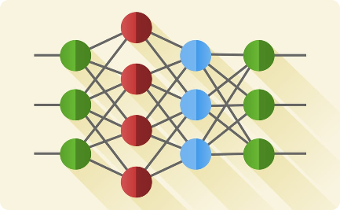


AI Integration and Optimization with NLP
Machine Learning
Voice Assistants
Search Engine Optimization
NLP can use machine learning to improve search results based on user interactions with search engines.
Voice assistant search engines are powered by NLP, which allows them to understand natural, conversational language.
NLP is making SEO more targeted and personalized, improving search accuracy and reducing irrelevant results.

Slide 4
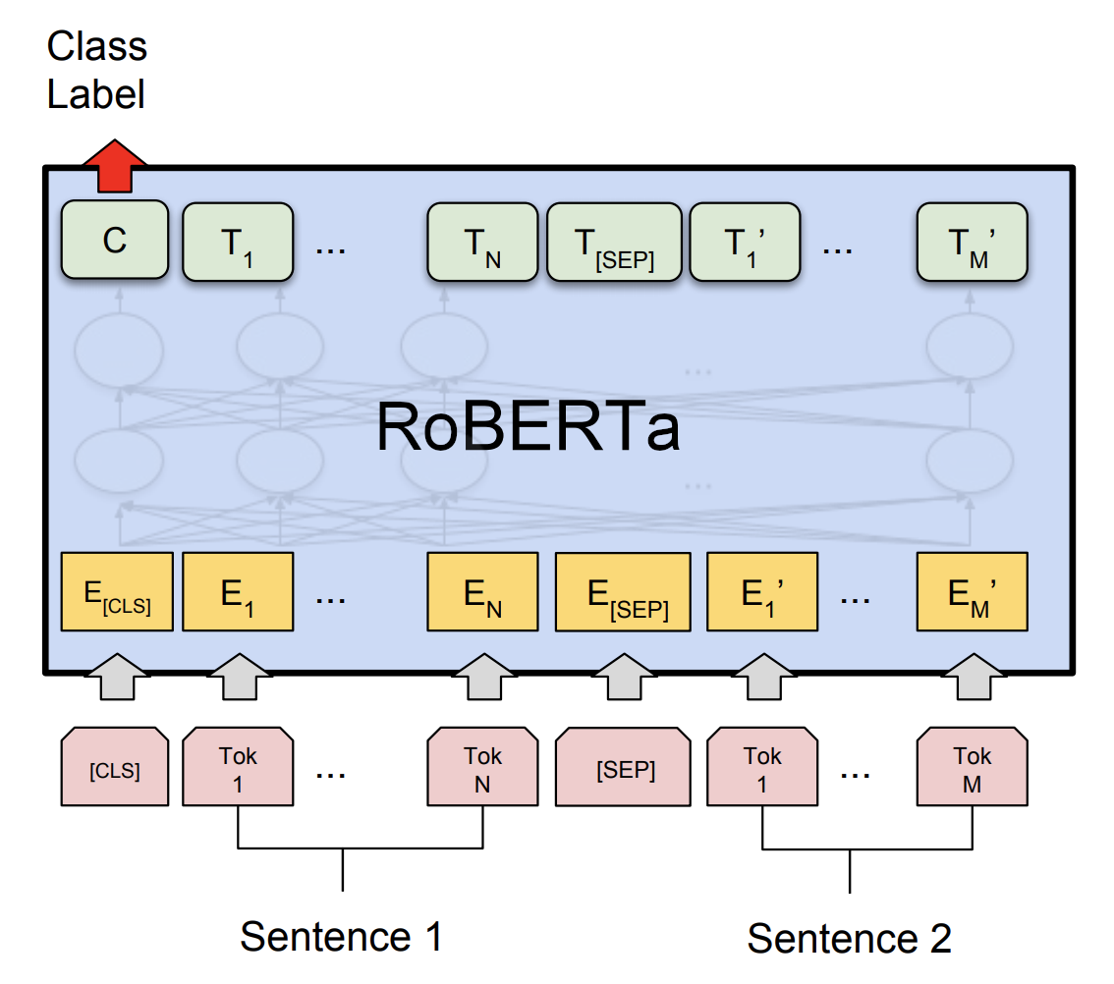
Real World Application #1
RoBERTa
1. Facebook AI open-sourced RoBERTa, a deep-learning NLP model based on Google's BERT architecture.
2. RoBERTa includes pre-training improvements, such as dynamic masking and larger mini-batch sizes, and achieves state-of-the-art results on NLP benchmarks using only unlabeled text from the web.
3. The Facebook team re-implemented BERT in PyTorch, made hyperparameter changes, and trained the model with more data and iterations.
4. RoBERTa surpassed BERT's performance on various NLP tasks, including GLUE, SQuAD, and RACE benchmarks, and it outperformed XLNet in some cases.
5. RoBERTa has become widely used in research and industry applications and serves as a base model for various successful NLP models.
Datasets used to train RoBERTa model:
BOOK CORPUS and English Wikipedia dataset
CC-NEWS
OPENWEBTEXT
STORIES

Slide 5
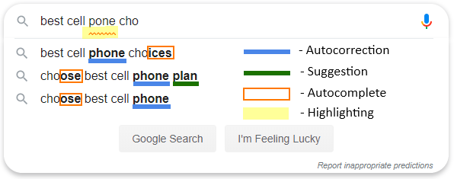
Real World Application #2
AUTOCOMPLETE &
AUTOCORRECT
Autocomplete
a feature that suggests possible search queries as users start typing in the search bar.
Working:
User input
NLP processing
Suggestions
Real-time updates
2. Autocorrect
a feature that automatically corrects spelling or typing errors in a user's query to improve search results. NLP is used to identify and rectify these errors.
Working:
User input
Error detection
Correction
Improved results

Slide 6
Benefits of Integrating AI with Search Engines
1
Efficient and Accurate
NLP-powered search engines can save users time and increase accuracy of search results.
Personalized to Your Needs
2
Search engines can use AI and NLP to provide personalized search results based on user search history and behaviors.
3
Improved User Experience
NLP-powered search engines provide a more natural and intuitive search experience, making search less overwhelming and more enjoyable.

Slide 7
Challenges of AI Integration with Search Engines using NLP
Data Privacy and Security Concerns
Content Censorship and Bias
Unemployment and Socioeconomic Inequality
AI searches collect vast amounts of personal data, raising privacy and security concerns.
There is a risk of AI-powered search engines being used to censor content, or perpetuating bias in search results.
The use of AI in search engines may lead to job displacement and worsen socioeconomic inequality, which is already a challenging problem in our world.

Slide 8
Ethical Considerations in AI-Powered Search Engines
1
Transparency and Explainability
AI-powered search engines should be transparent and explainable, so users know how results are generated, and any biases or assumptions that drive these results.
Accountability and Responsibility
2
Organizations must be accountable and responsible for the use of AI in search engines, particularly when it comes to matters that affect privacy and data security.
3
Cultural Sensitivity and Diversity
AI-powered search engines should be sensitive to cultural diversity and avoid perpetuating and amplifying stereotypes and biases.

Slide 9



The Future of AI-Powered Search Engines using NLP
Greater Precision and Accuracy
Improved Voice Assistant Capabilities
Enhanced Multilingual Capabilities
As AI and NLP technology advances, search engines will become more precise in interpreting natural language, leading to more accurate search results.
Voice assistant search engines will continue to improve in understanding and responding to natural language queries, providing a more conversational and human-like search experience.
AI-powered search engines will become more adept at handling multiple languages, catering to a diverse global audience.

Slide 10

THANK
YOU!!!!

